Slide 1
Segmentation of Bone Marrow on ¹⁸F-FDG PET/CT Images
Daniel Huff
CS 766, Spring 2018

Slide 2
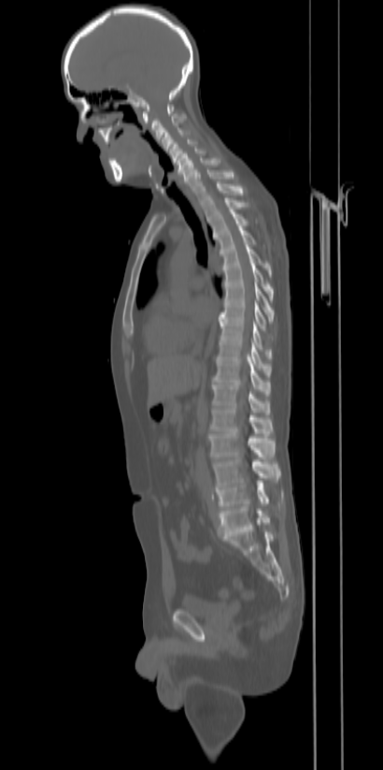
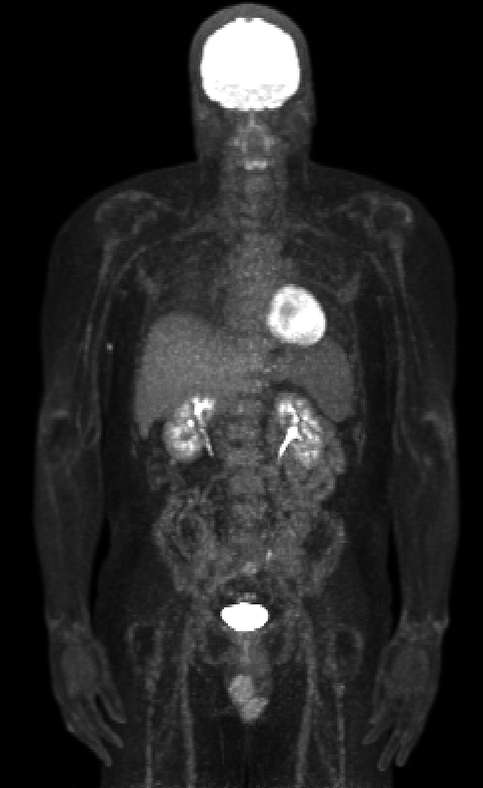
Background: PET/CT Imaging
CT: sagittal view
FDG PET: coronal view
CT – Computed Tomography
3D x-ray transmission imaging
Provides anatomical information
PET – Positron Emission Tomography
¹⁸F-FDG – distribution of glucose metabolism
Provides functional information

Slide 3
Background: Quantitative Bone Marrow Analysis
Quantification FDG PET uptake of bone marrow is important for several diseases:
Cancers that affect bone marrow
Multiple Myeloma¹
Leukemia²
Lymphoma³⁻⁵
Oncology patients receiving immunotherapies^{6,7}
Other researchers have addressed this problem, but with limitations:
Perk et al (2016) – different radiotracer⁸
Nguyen et al (2017) – vertebral marrow only, requires other manual inputs⁹
Leydon et al (2016) – no consideration of separate vertebrae, manual inputs, other simplifications¹⁰
Currently, PET images are used semi-quantitatively due to the expert physician time commitment required for manual segmentation – automation can address this

Slide 4
Methods: Outline
Whole Bone segmentation
Bone Marrow segmentation
Vertebral marrow
Other marrow

Slide 5
Methods: Outline
Whole Bone segmentation
Bone Marrow segmentation
Vertebral marrow
Other marrow

Slide 6
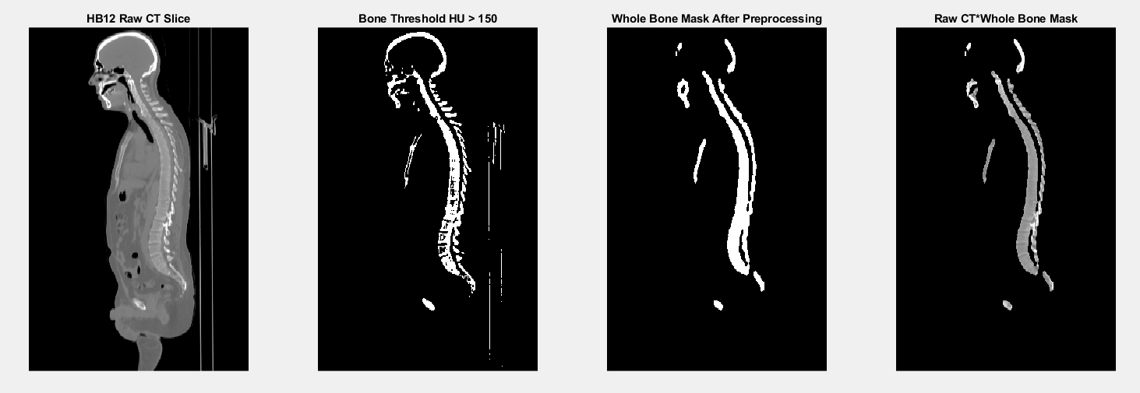
Methods: Whole Bone Segmentation
Input CT
Threshold high density regions
HU > 150
Morphological open, close
Remove table
Mask CT or PET with bone mask for whole bone segmentation

Slide 7
Methods: Outline
Whole Bone segmentation
Bone Marrow segmentation
Vertebral marrow
Other marrow

Slide 8
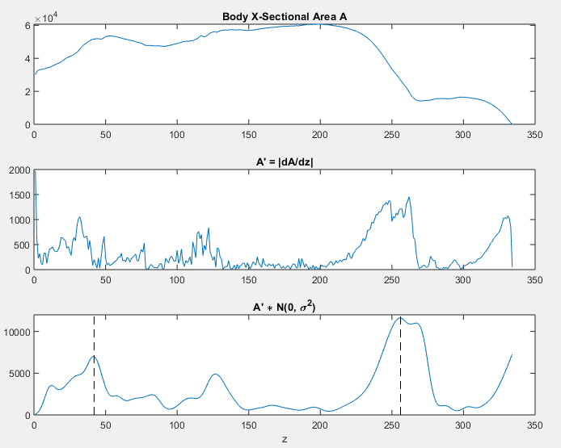
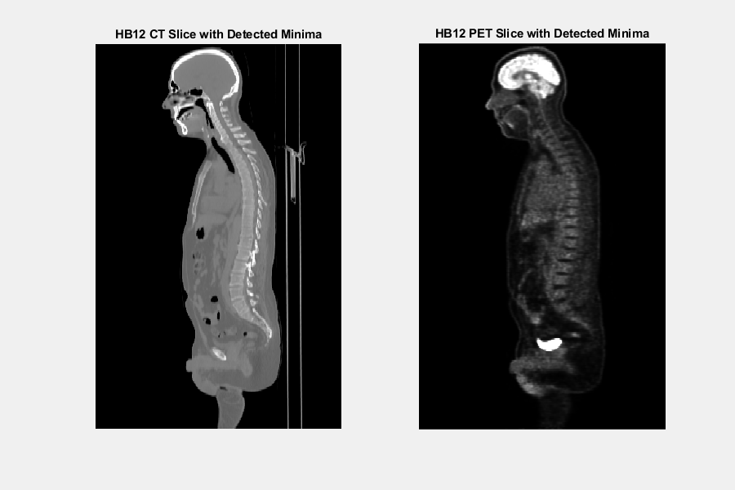
Methods: Vertebral Marrow Segmentation Localization of Shoulders and Pelvis
Axial sum of PET mask = measure of body x-sectional area
Strongest peaks at shoulders, pelvis

Slide 9
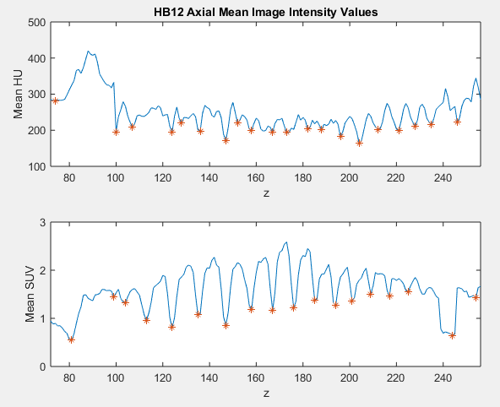
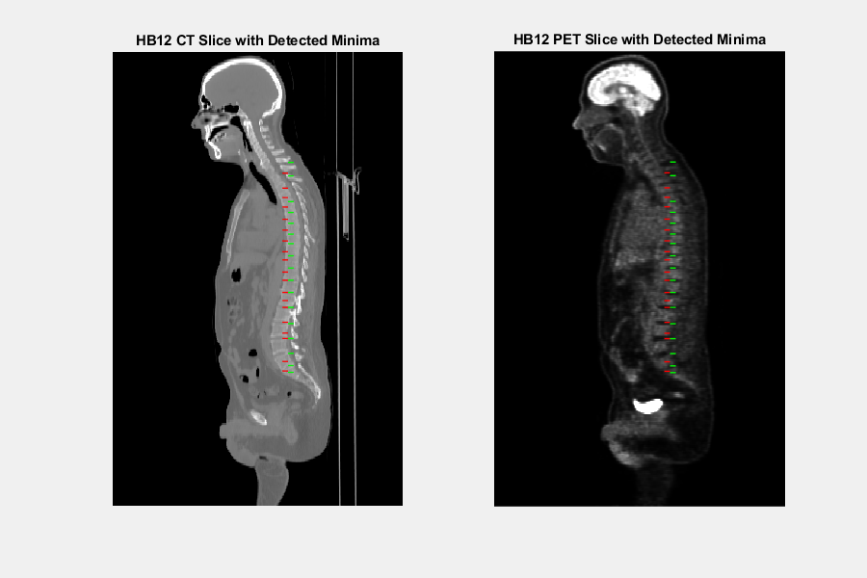
Methods: Vertebral Marrow Segmentation Detection of Intervertebral Disks
Axial minima correspond to intervertebral disks
Detected minima (Red = CT, Green = PET)

Slide 10
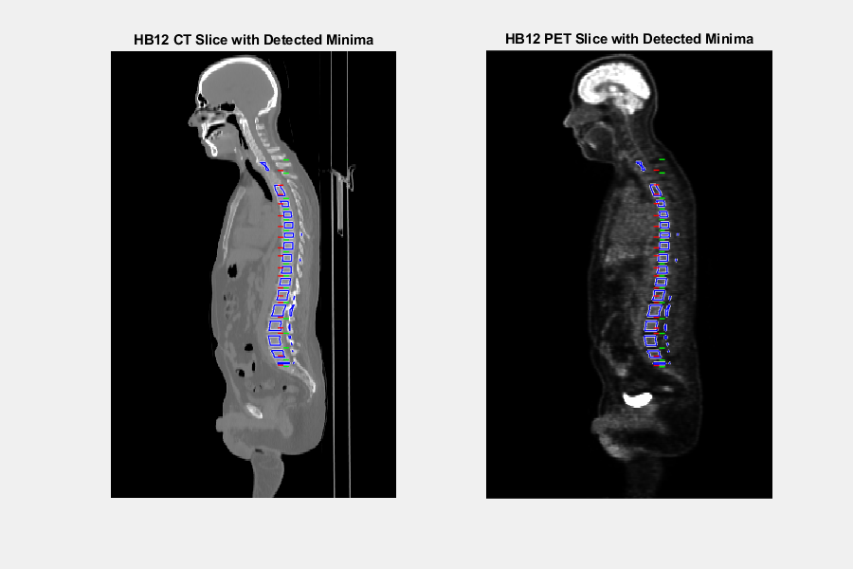
Methods: Vertebral Marrow Segmentation Erosion of Bone Mask Segments
Detected minima (Red = CT, Green = PET)
Final Vertebral Marrow Segmentation (Blue)
Erosion of bone mask segments between adjacent minima

Slide 11
Methods: Outline
Whole Bone segmentation
Bone Marrow segmentation
Vertebral marrow
Other marrow

Slide 12
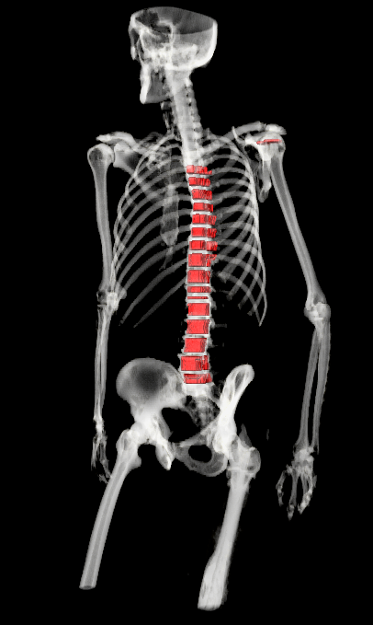
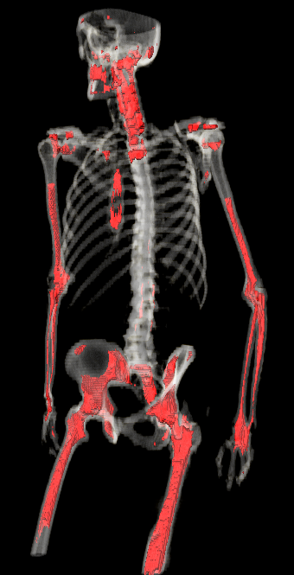
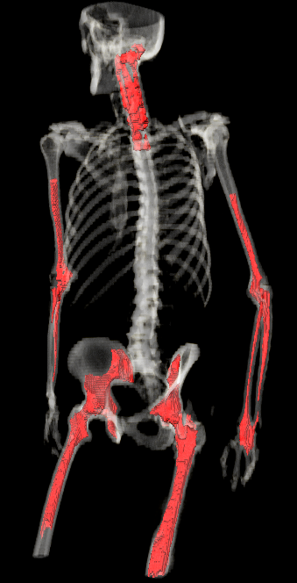
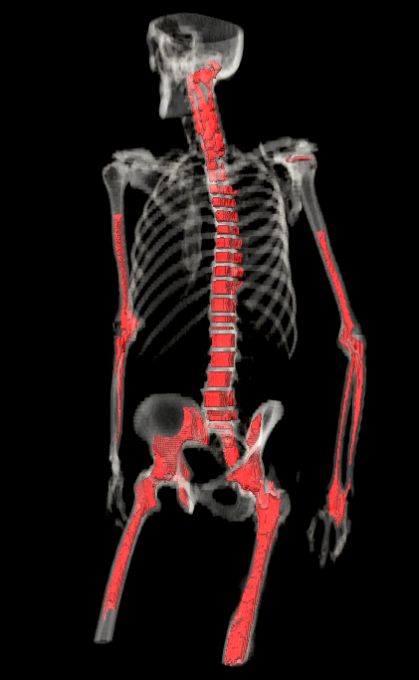
Methods: Other Marrow Segmentation
Input final vertebral marrow segmentation
Subtract vertebral marrow from whole bone mask
Erode hard bone
Select largest components as other marrow
Union of vertebral, other marrow is final segmentation

Slide 13
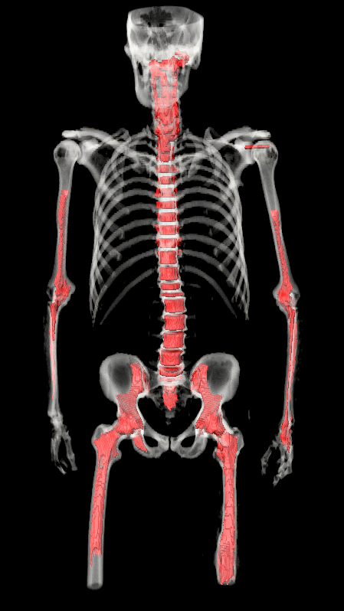
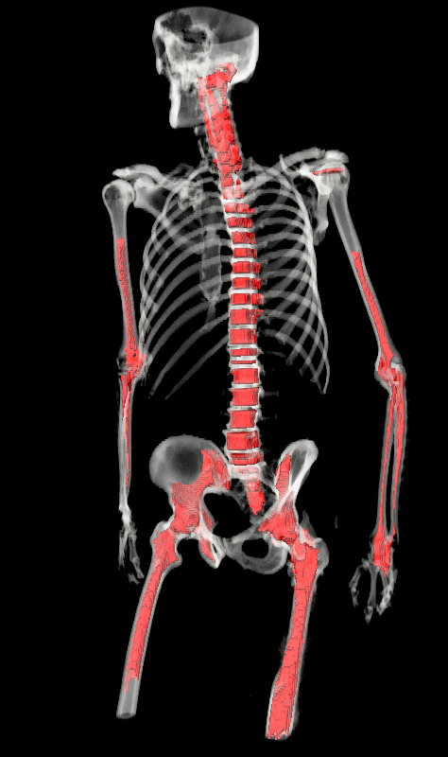
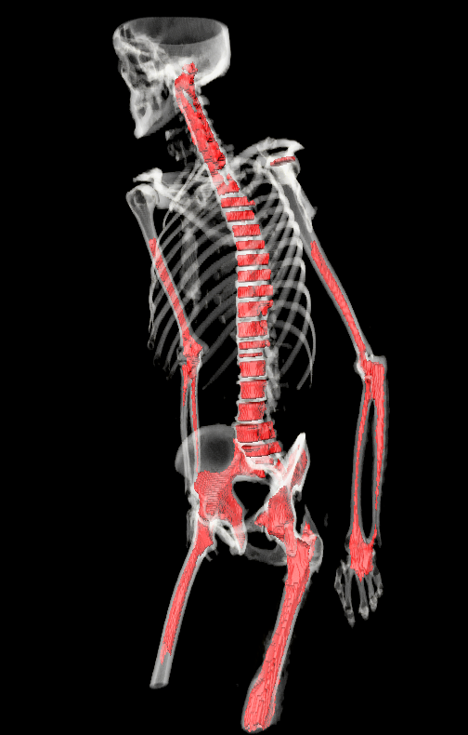
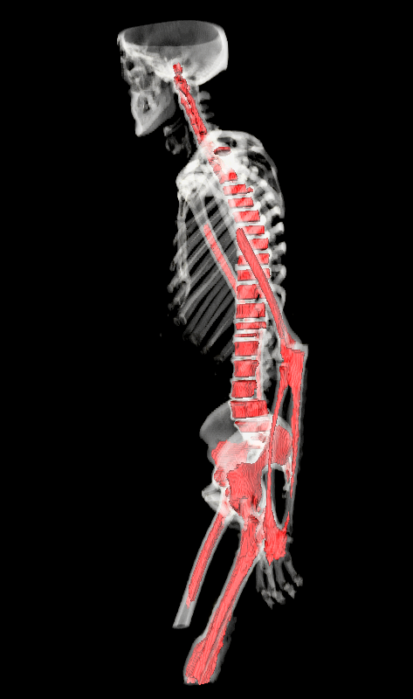
Sample Results: Final Marrow Segmentation
Coronal
Sagittal

Slide 14
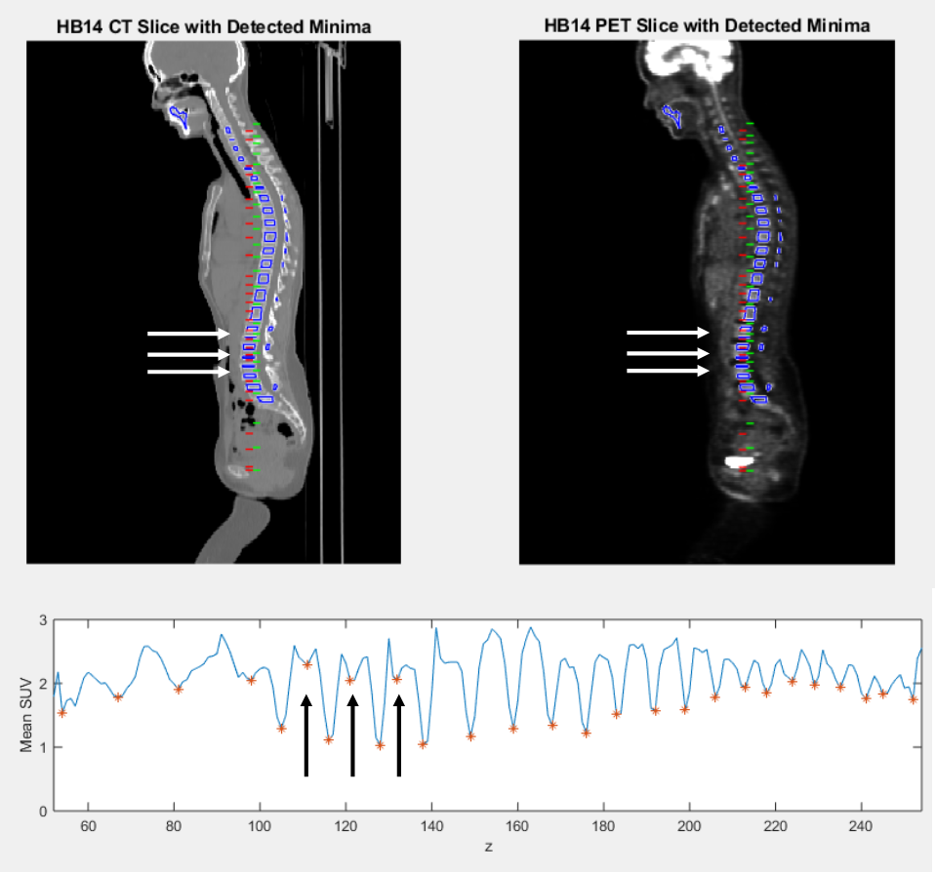
Sample Results: Vertebra Failure Possibilities False Positives
False positive disk location causes split vertebra segmentation
Most prevalent in L spine, where vertebra are tallest

Slide 15
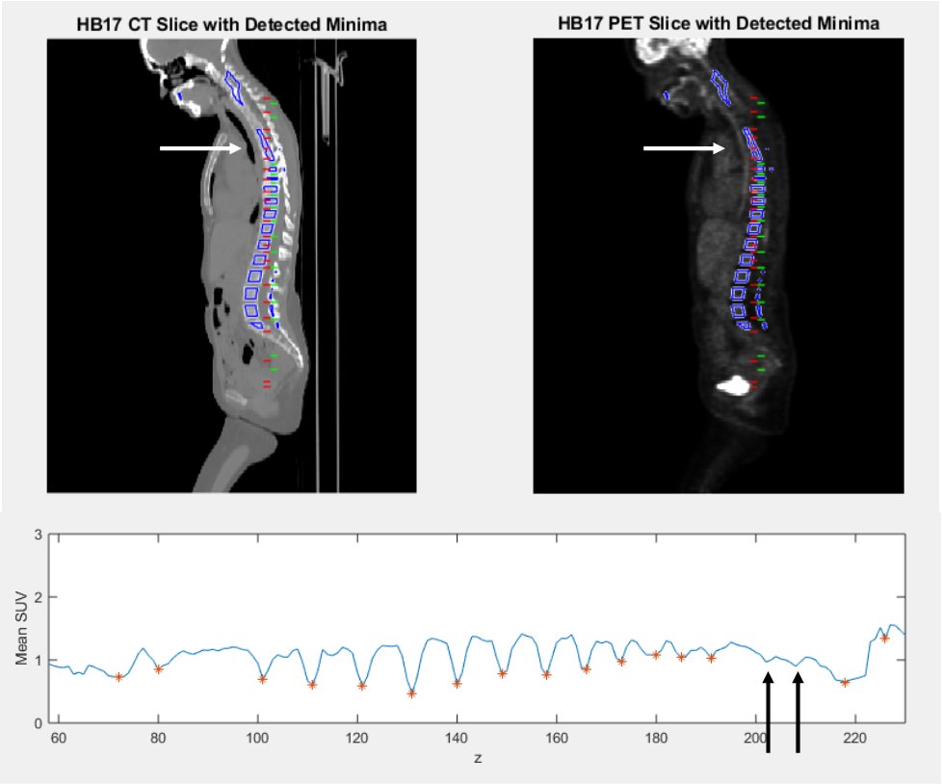
Sample Results: Vertebra Failure Possibilities False Negatives
Missed disk location leads to fused marrow segmentation
Most prevalent in C spine
Vertebra are smaller
Intervertebral disks may be a single voxel
Vertebra may be tilted if patient is not supine

Slide 16
Discussion: Moving Forward
Method performs reasonably in most of cohort of 30 patients
Current run time: 120 seconds/patient
Two planned improvements:
Kalman filtering of intervertebral disk location for false positive rejection
Transition to model-based approach¹¹ to address multiple current issues:
Incomplete bone segmentation
Shoulder, pelvis localization
Remove reliance on multiple engineered parameters

Slide 17
Conclusions
Development of a simple framework for 3D segmentation of bone marrow on ¹⁸F-FDG PET/CT images
Future transition to a model-based approach should address some shortcomings of this approach
Applications for disease staging, treatment management, treatment response assessment for multiple diseases

Slide 18
References
¹ Sachpekidis, C., et al. "Assessment of glucose metabolism and cellular proliferation in multiple myeloma: a first report on combined 18 F-FDG and 18 F-5 FLT PET/CT imaging." EJNMMI research 8.1 (2018): 28.
² Stölzel, Friedrich, et al. "18F-FDG-PET/CT for detection of extramedullary acute myeloid leukemia." Haematologica 96.10 (2011): 1552-1556.
³ Barrington, Sally F., et al. "Role of imaging in the staging and response assessment of lymphoma: consensus of the International Conference on Malignant Lymphomas Imaging Working Group." Journal of clinical oncology 32.27 (2014): 3048.
⁴ Berthet, Louis, et al. "In newly diagnosed diffuse large B-cell lymphoma, determination of bone marrow involvement with 18F-FDG PET/CT provides better diagnostic performance and prognostic stratification than does biopsy." Journal of Nuclear Medicine 54.8 (2013): 1244-1250.
⁵ Herrmann, Ken, et al. "Early response assessment using 3′-deoxy-3′-[18F] fluorothymidine-positron emission tomography in high-grade non-Hodgkin's lymphoma." Clinical Cancer Research 13.12 (2007): 3552-3558.
⁶ Ferté, Charles, and Aurélien Marabelle. "iRECIST: A clarification of tumour response assessment in the immunotherapy era." European Journal of Cancer 77 (2017): 165-167.
⁷ Seymour, Lesley, et al. "iRECIST: guidelines for response criteria for use in trials testing immunotherapeutics." The Lancet Oncology 18.3 (2017): e143-e152.
⁸ Perk, Timothy G., et al. "A method for quantitative total marrow imaging (QTMI) with PET/CT." Biomedical Physics & Engineering Express 2.5 (2016): 055006.
⁹ Nguyen, Chuong, et al. "An automatic 3D CT/PET segmentation framework for bone marrow proliferation assessment." Image Processing (ICIP), 2016 IEEE International Conference on. IEEE, 2016.
¹⁰ Leydon, P., et al. "Automatic bone marrow segmentation for PETCT imaging in multiple myeloma." Physica Medica: European Journal of Medical Physics 32 (2016): 242.
¹¹ Yip, Stephen, Timothy Perk, and Robert Jeraj. "Development and evaluation of an articulated registration algorithm for human skeleton registration." Physics in Medicine & Biology59.6 (2014): 1485.

Slide 19
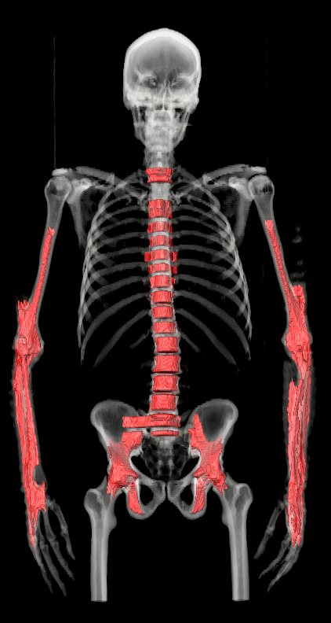
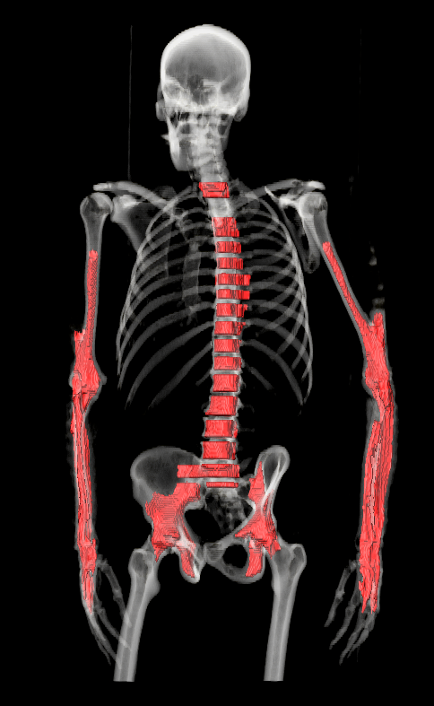
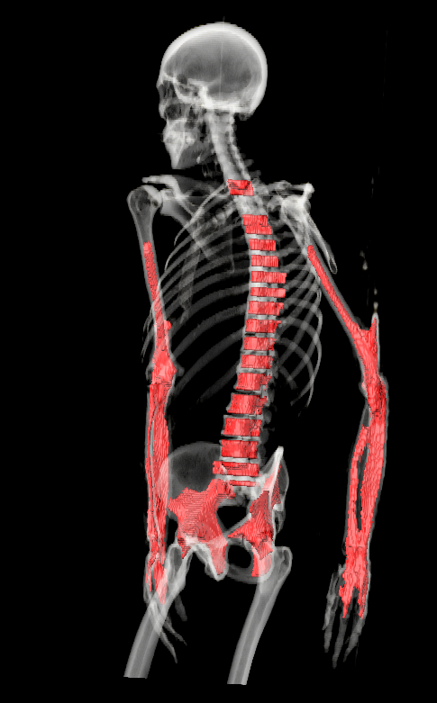
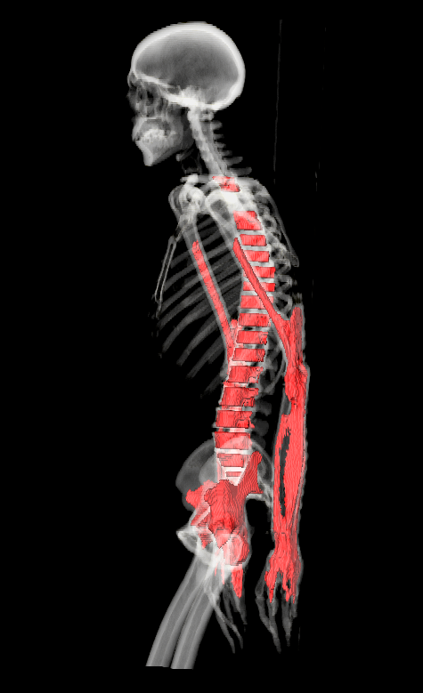
Sample Results: Final Marrow Segmentation 2
Coronal
Sagittal

